Slide 1
Sampling methods
This presentation is based on L.V. Graduer “Stratification” materials: https://stepik.org/media/attachments/lesson/26213/strata.pdf

Slide 2
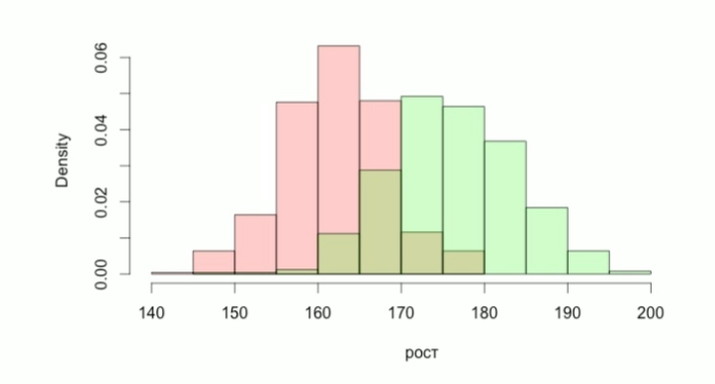
Stratification:
Population height.
Female 54%, Man 46%
Height

Slide 3
Stratification examples:
Population can be grouped into clusters (or stratas) basing on geographic location;
Internet users – by a browser used;
Financial transactions – by transaction scale: large, medium, small.

Slide 4
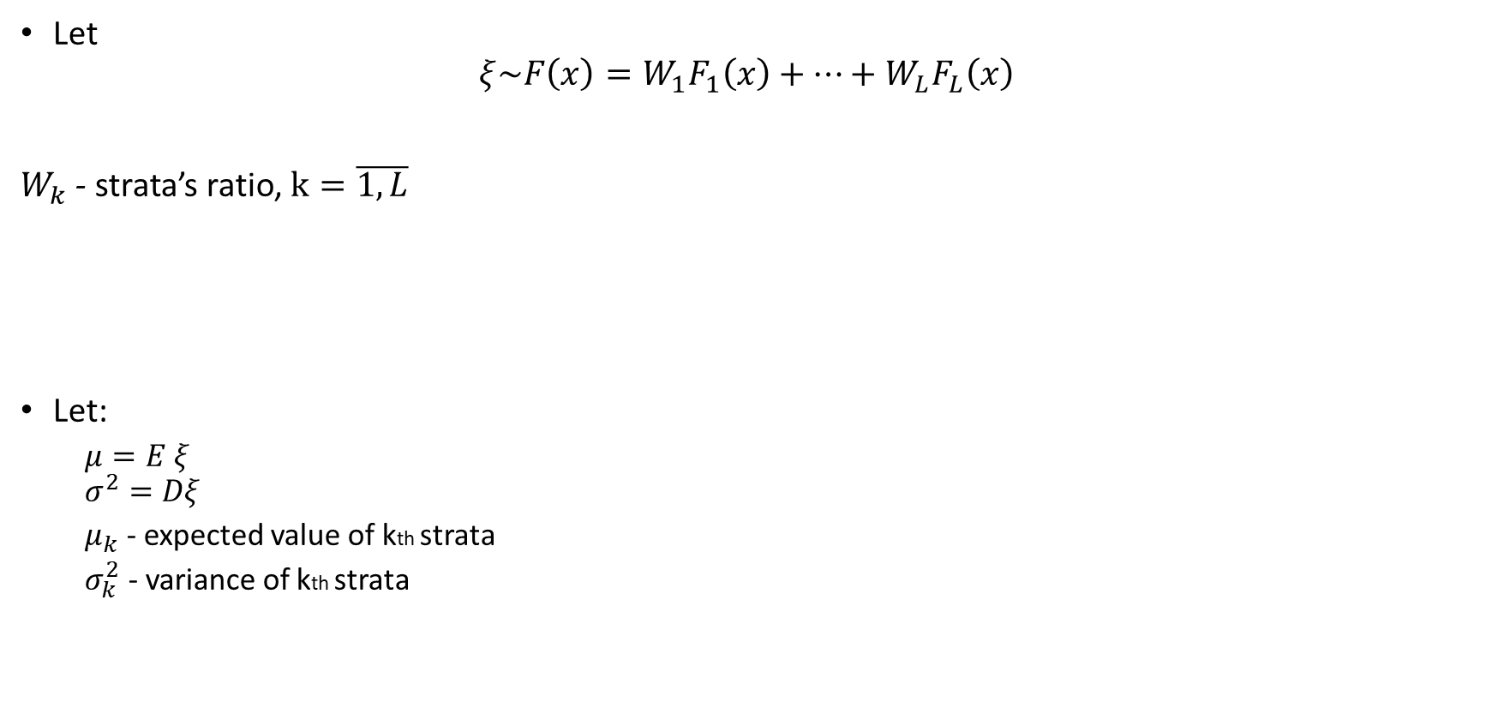
A mixture of distributions:

Slide 5
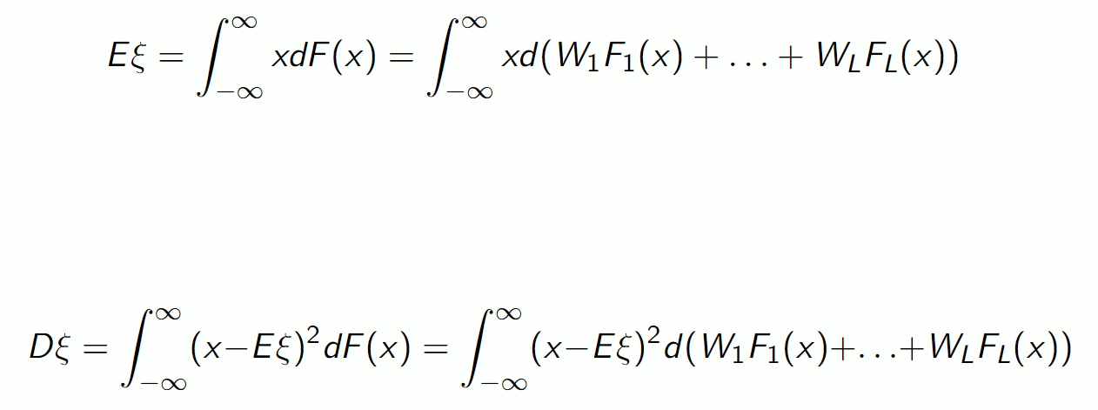
Expected value and variance:

Slide 6

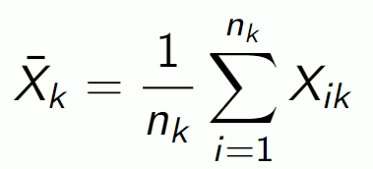
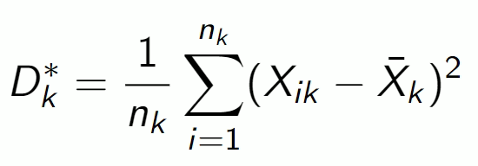
Stratified samples:
Within the kth strata let’s take a sample of volume nk:
Then it’s sample mean:
It’s sample variance:

Slide 7
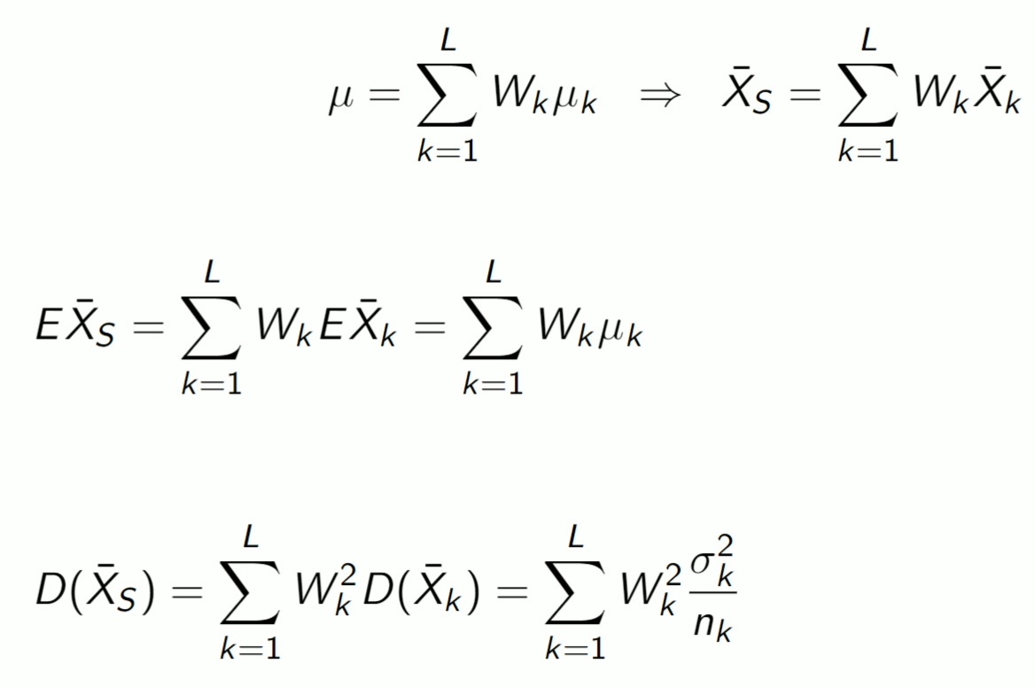
Mean expectation estimation for a mixture:
- mixture sample mean
- EV of mixture sample mean
- Variance of mixture sample mean

Slide 8
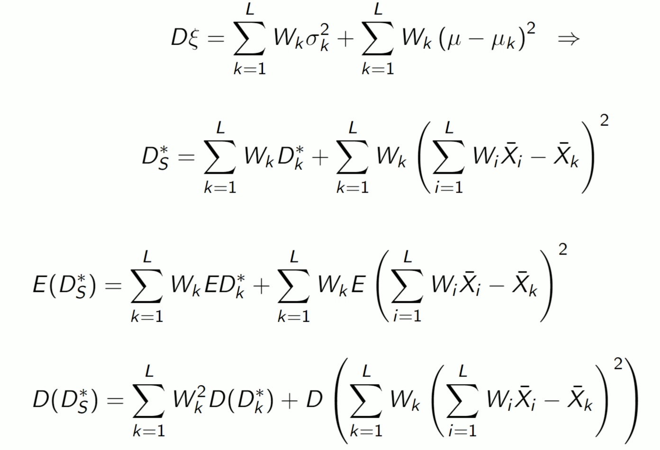
Variance estimation for a mixture:
- mixture sample variance
- EV of mixture sample variance
- Variance of mixture sample variance

Slide 9
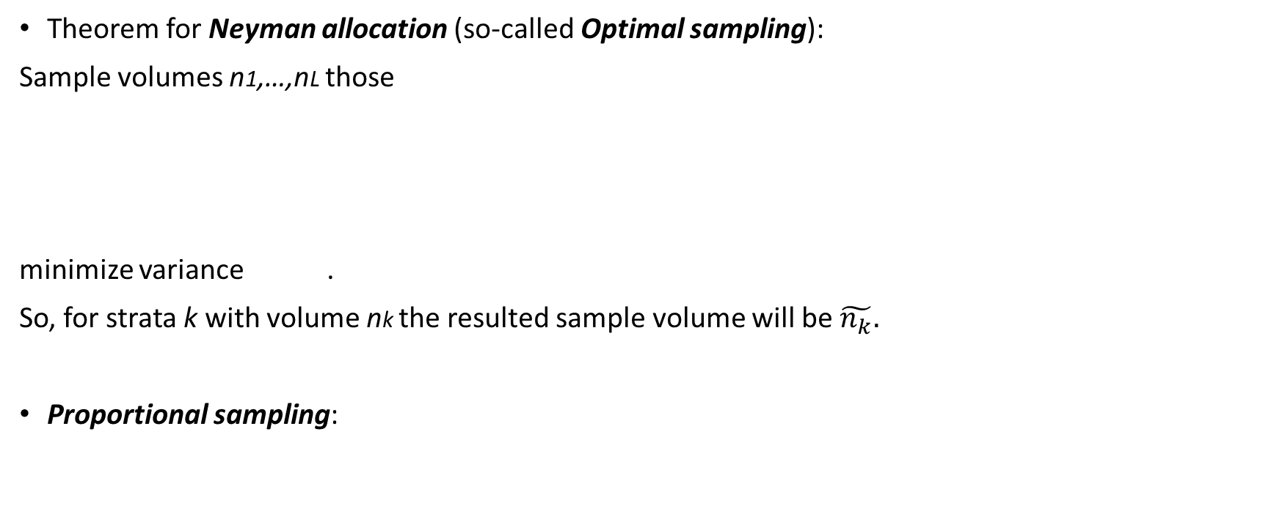
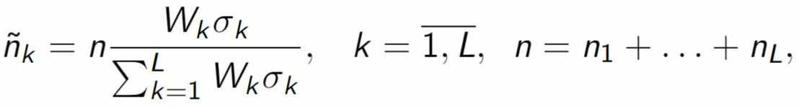

How to choose sample volumes of stratas?

Slide 10
Why use stratas?
To reduce variance for estimation of unknown parameters
To add objects from different stratas in a sample (it may not happen with plain random sampling)

Slide 11
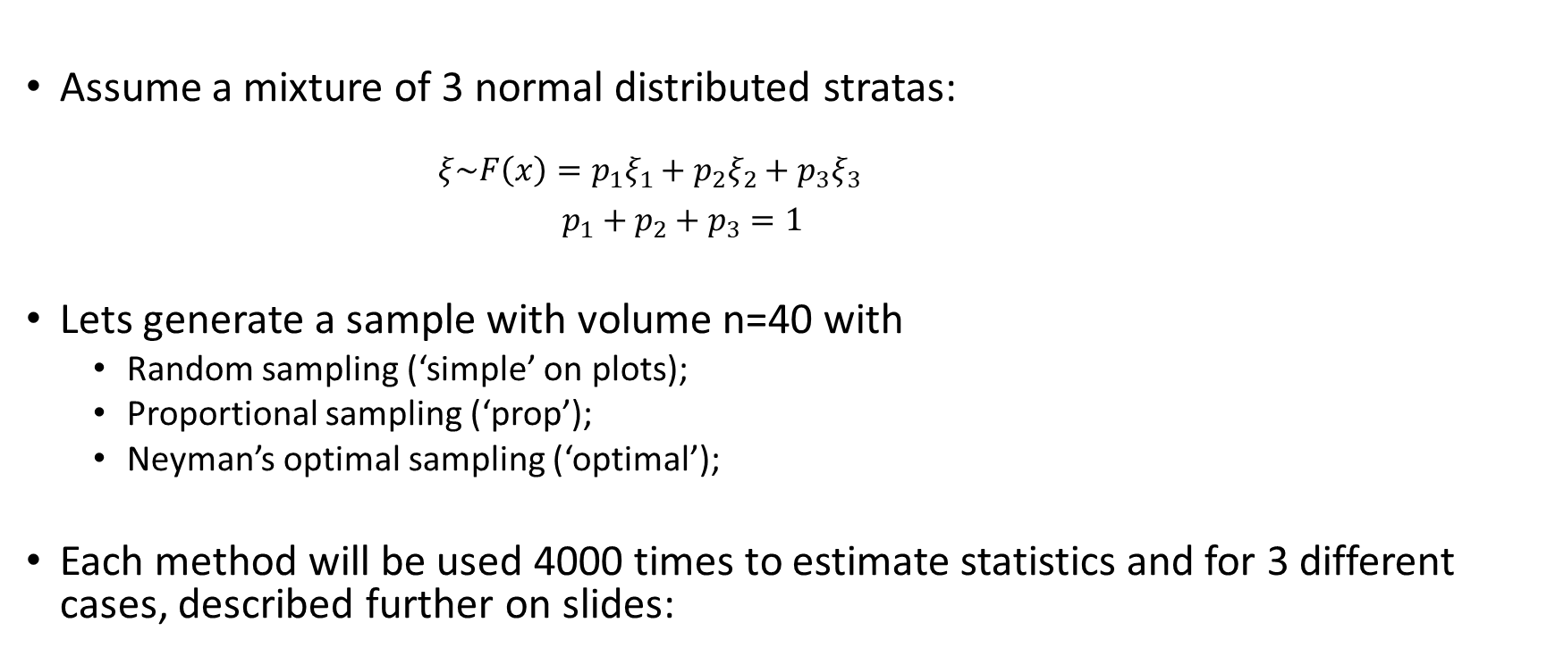
Example:

Slide 12
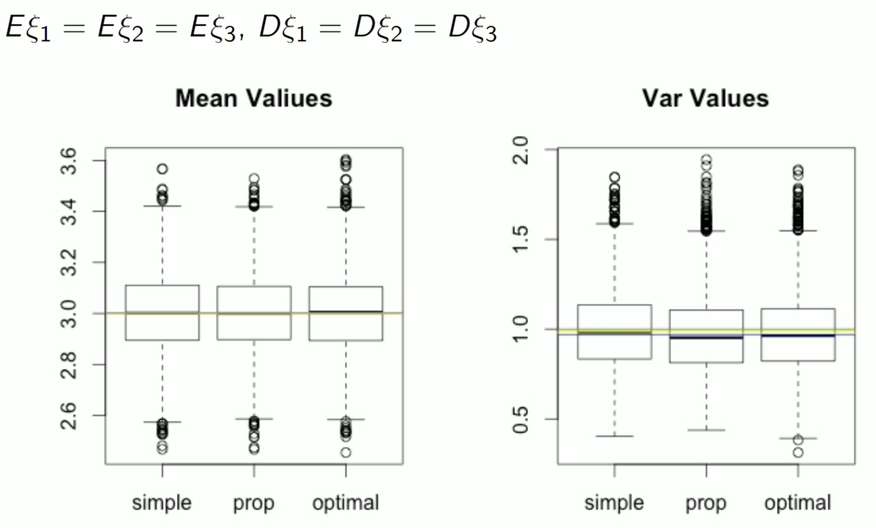
1. Equal EV and equal variances:

Slide 13
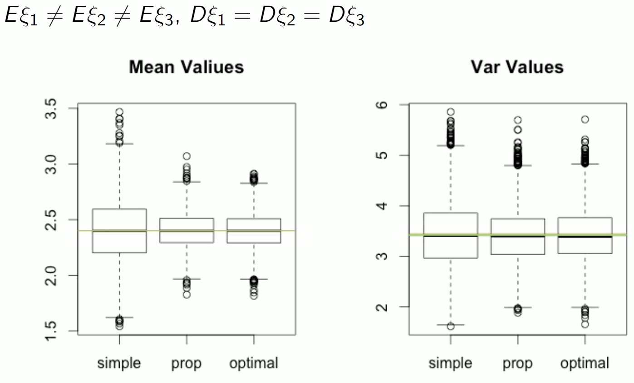
2. Different EV and equal variances:

Slide 14
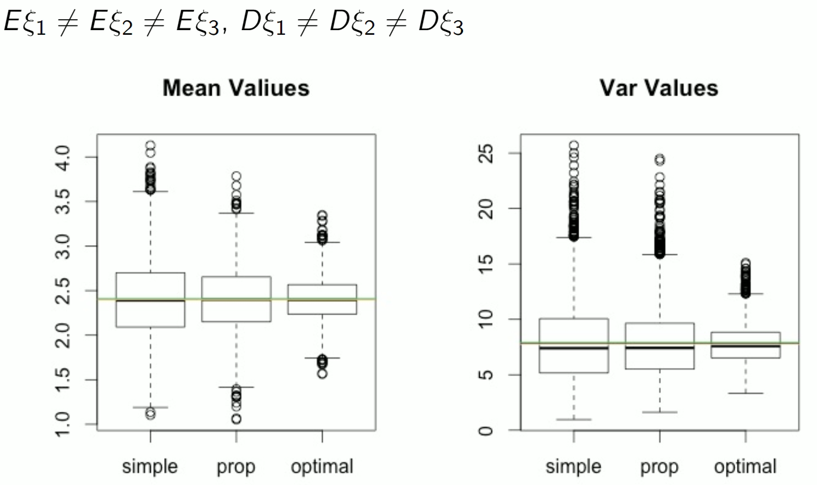
3. Different EV and different variances:

Slide 15
Summary of boxplots:
Optimal sampling helped to generate samples with lower sample mean variance;
Thus the interquartile range is lower both for sample variance and sample mean;
But if the stratas’ EV and Variances are equal, there is no such an advantage.

